Slide 1
Introduction
Proposed approach
Results
Conclusion
References
TRAIN-TRIPPER
Machine Learning (IE 406)
Instructor - Dr. M.V.Joshi
Bhavya Rajdev - 202001067
Maharth Thakar- 202001069
Dhruv Prajapati- 202001103
Dhirubhai Ambani Institute of Information and Communication Technology (DA-IICT), Gandhinagar, Gujarat
Train Tripper

Slide 2
Introduction Proposed approach
Introduction
Results
Conclusion
References
Problem: Though travel planning with one train is easy, there are no systems that help plan the long multi-days multi-train travel which is a problem.
Background: Evolution of train transportation technology
Objectives:
Data Collection and database creation
Search algorithm and optimization
Model development, hyperparameter tuning
Final Combing step and creating user API
Train Tripper

Slide 3
Introduction Proposed approach
Initial Research
Results
Conclusion
References
1> Forecasting dynamic ticket prices for spanish trains using the historical data and number of days before search.
2> Machine Learning Project where they predicted whether a customer will pass through a wait-list on IRCTC.
We tried to contact with the authors of these papers to help collect the data for Indian trains but we couldn’t do it.
Train Tripper

Slide 4
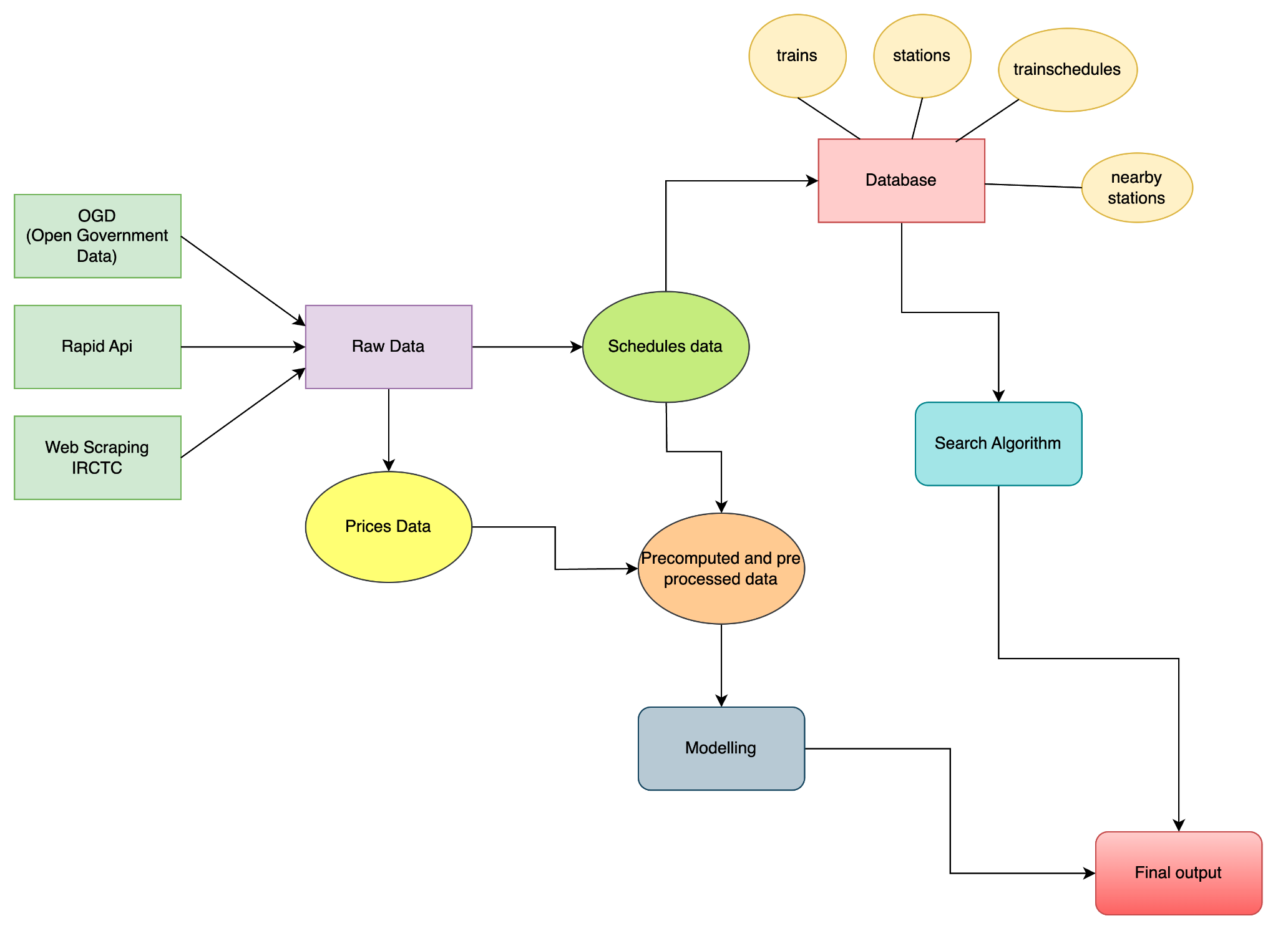
Introduction
Proposed approach
Results
Conclusion
References
System Design
Simultaneous Inpainting and Susolution
Train Tripper

Slide 5
Introduction Proposed approach
Data Collection:
Results
Conclusion
References
OGD and Rapid-API exploration
OGD platform provided a dataset containing train details but data was seven years old.
Rapid-API, although a public API for data retrieval, posed limitations in terms of free requests and cost.
Web scraping for real-time price data
Web scraping techniques were employed to extract real-time price data from the IRCTC website, offering a cost-effective alternative to paid API services.
Train Tripper

Slide 6
Introduction Proposed approach
Database Creation
Results
Conclusion
References
Schema Design:
Designed to accommodate essential information related to trains, train schedules, stations, and nearby stations.
Tables: trains, train schedules, stations, nearby stations
Data Population:
Populate with schedule data
Creation of additional tables
Train Tripper

Slide 7
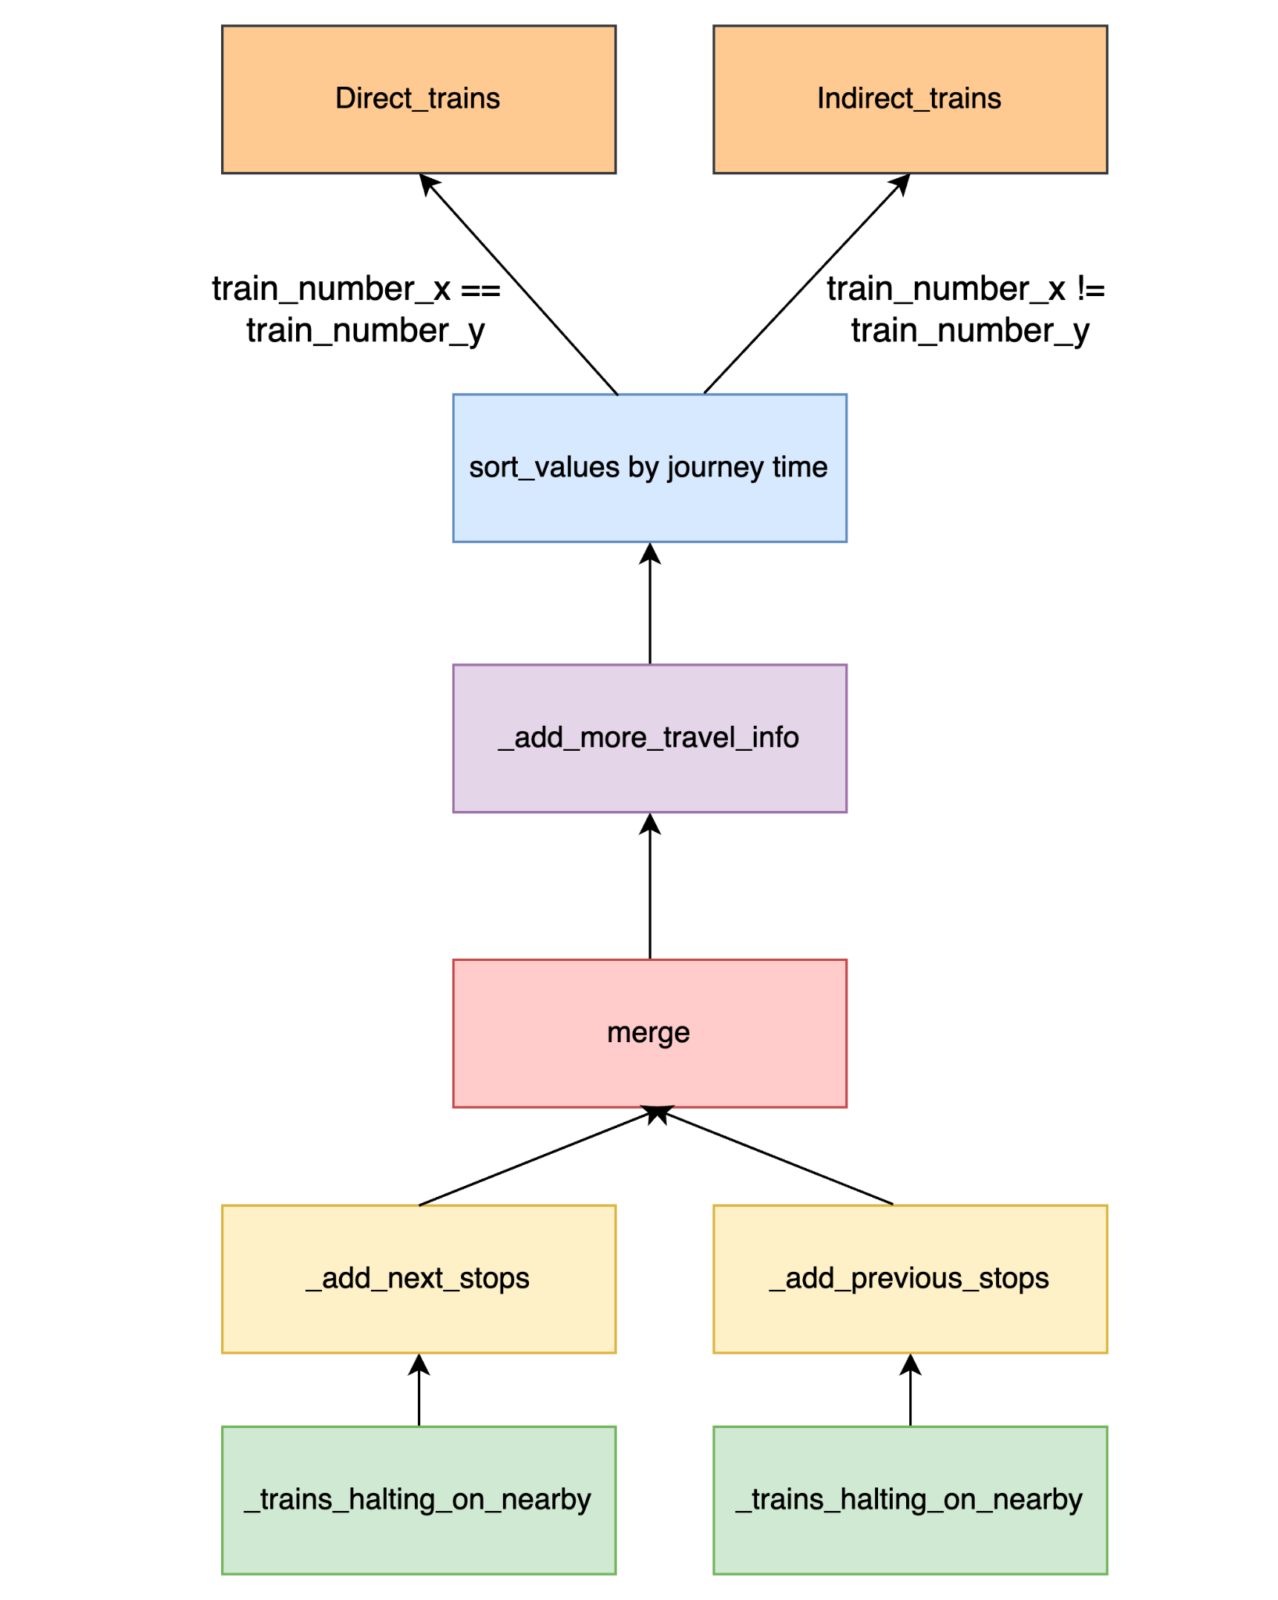
Introduction Proposed approach
Search Algorithm
Results
Conclusion
References
1> Find nearby stations from both source and destination stations and all the halting trains on those stations
2> ext stops to the possible source stations and adding previous stops to the possible destination stations.
3> In merge step, we find possible halting stops for our multi-train journeys.
4> Add the halt time details and more travel info like travel time.
5> Finally sort the data frame by journey time and filter to direct and indirect trains.
Train Tripper

Slide 8
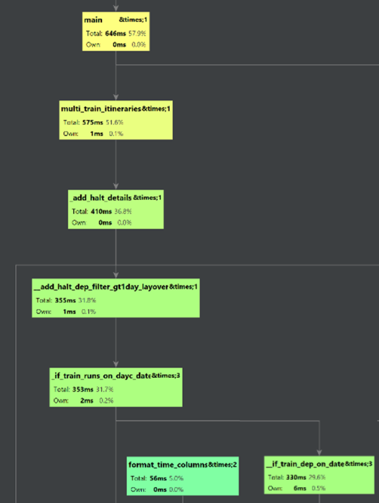
Introduction Proposed approach
Search Optimization
Results
Conclusion
References
The use of vectorized operations helped reduce the time of search algorithm from 4-5 seconds to around 600 milliseconds.
Dataframe operations like ‘apply’ fully iterate the
Dataframe to produce results. However vectorized operations doesn’t iterate and thus faster
Train Tripper
Notes:
Using of vectorized operations, which was tough to implement instead of the iterations on the data which was easier to implement.
The use of vectorized operations helped reduce the time of search algorithm from 4-5 seconds to around 600 milliseconds.

Slide 9
Introduction Proposed approach
Algorithm Steps and Results
Results
Conclusion
References
Optimization:
Performance improvement from 4 seconds to 575ms
Detailed in commit history and performance directory
Verification and Results:
Checked against direct trains on IRCTC
Replicated IRCTC results
Added functionality for indirect trains
Example - Mumbai to Delhi:
Comparison of direct and indirect trains
Display of best journey times for both direct and indirect trains
Train Tripper

Slide 10
Introduction Proposed approach
Data Pre-Processing
Results
Conclusion
References
Fares Analysis:
Analysis of different fare components which led to the precomputation of certain fare components to enhance the accuracy of the subsequent prediction model
Data Preparation:
Incorporation of distance and duration using a 'distance_map' variable.
One-hot encoding of class information to make it compatible with machine learning models.
Train Tripper

Slide 11
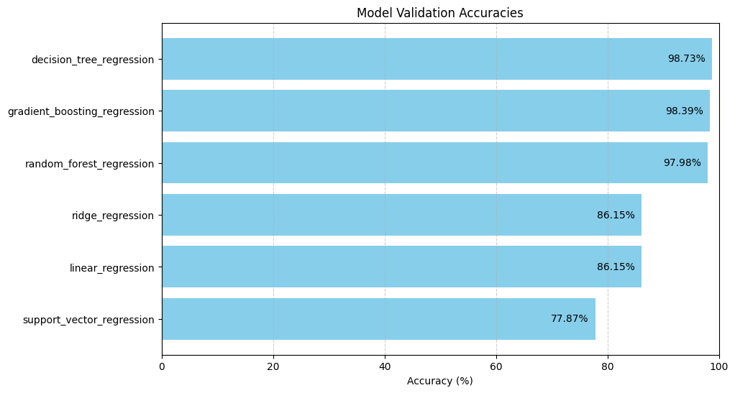
Introduction Proposed approach
Model Selection
Results
Conclusion
References
Experimentation with various models and tuning the hyperparameters
Models are evaluated using RandominzedSearchCV with n_params=5 and number of folds = 3
Decision Tree Regression performs best while SVM’s and linear regression models perform poorly.
Train Tripper

Slide 12
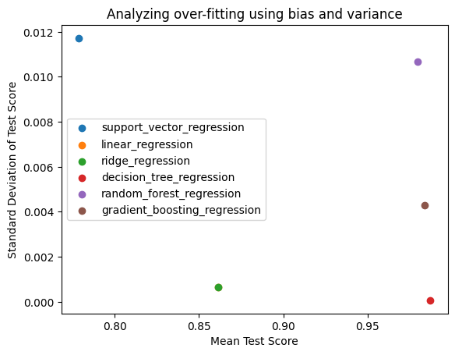
introduction Proposed approach Result Conclusion References
ef
Comparison of various models
Decision Tree Regression along with the best mean accuracy on all folds (bias), gives the best variance as well and thus best performing on unknown data.
The sequential nature of decision tree branches aligns with the human thought process.
Train Tripper

Slide 13
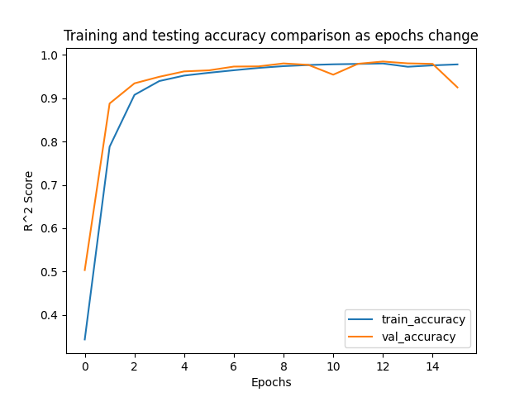
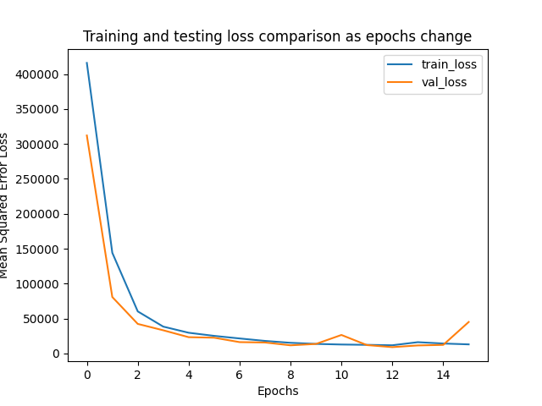
Introduction
Proposed approach
Results
Conclusion
References
Model Selection
For dense neural networks, using cross validation, we found out that the network with (hidden_layers=2, neurons=16, optimizer=adam, activation=relu) outperformed other models.
Not our choice of model, as not offering good accuracy even after multiple epochs.
Other simpler models performs better and gives more insights
Simultaneous Inpainting and Sr-resolution
Train Tripper

Slide 14
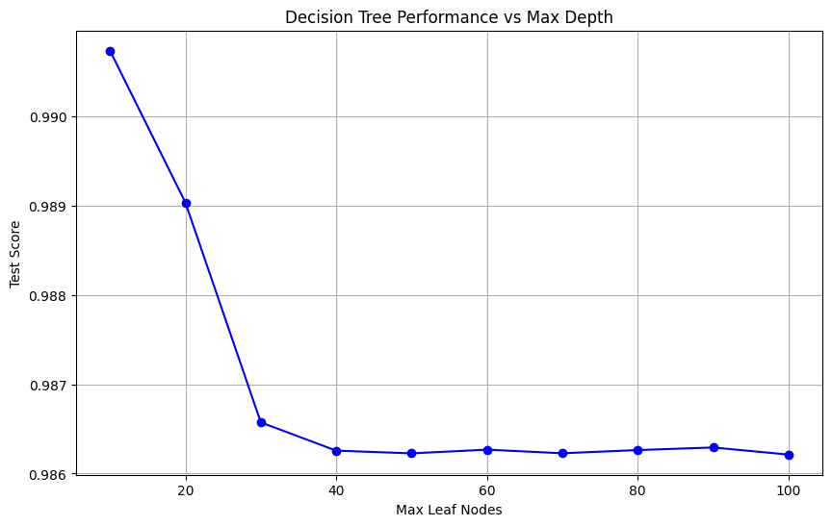
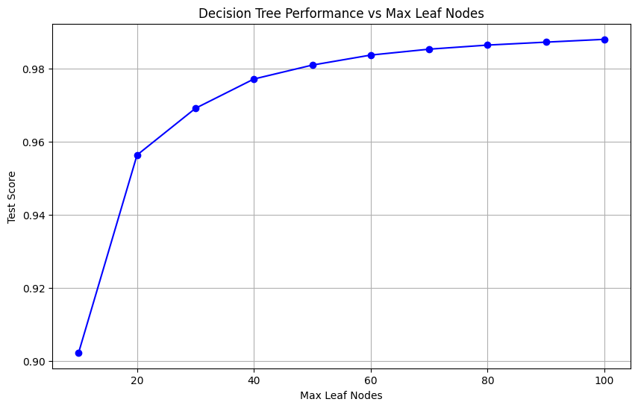
Introduction
Proposed approach
Results
Conclusion
References
Model Selection
These are the plots for test scores vs different hyperparameters of decision tree regression.
We found that the test score decrease on increasing of depth of tree and increase on
increase of maximum leaf nodes.
We fix the parameters max_depth=10 and max_leaf_nodes=50 for further analysis.
Simultaneous Inpainting and Sr-resolution
Train Tripper

Slide 15
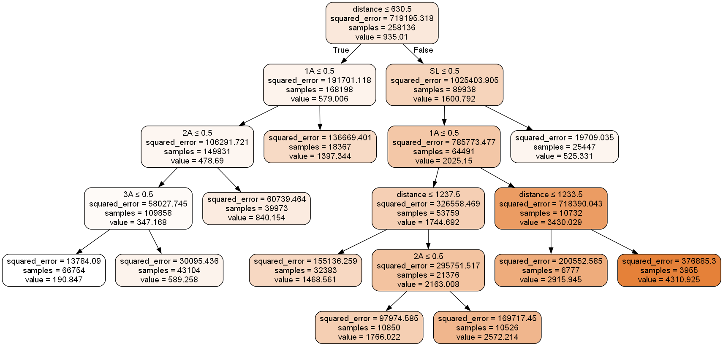
Introduction
Proposed approach
Results
Conclusion
References
Model Selection
Sample decision tree with max leaf nodes fixed as 10 which says that distance is the most important parameter for price prediction followed by the class codes.
Simultaneous Inpainting and Sr-resolution
Train Tripper

Slide 16
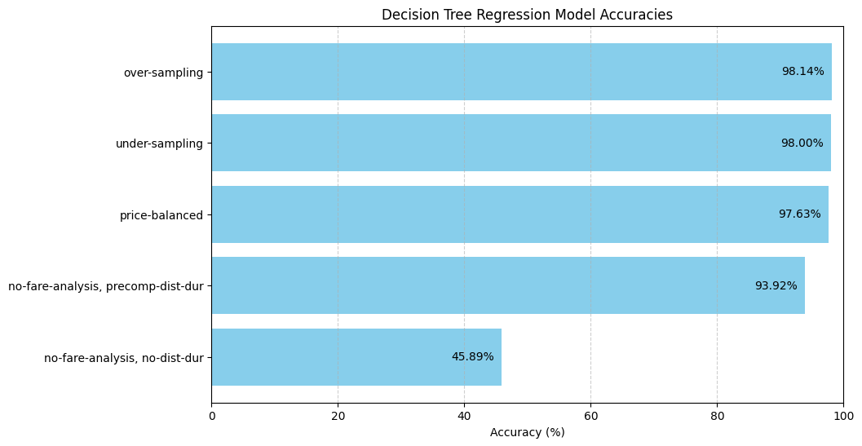
Introduction
Proposed approach
Results
Conclusion
References
Model Selection
We apply different conditions on data for building the model for example undersampling and oversampling on the class column using minimum and maximum number of data points on a class, price data balancing, masking different columns and find that oversampling on class data performs best on our data and save the model.
Simultaneous Inpainting and Sr-resolution
Train Tripper

Slide 17
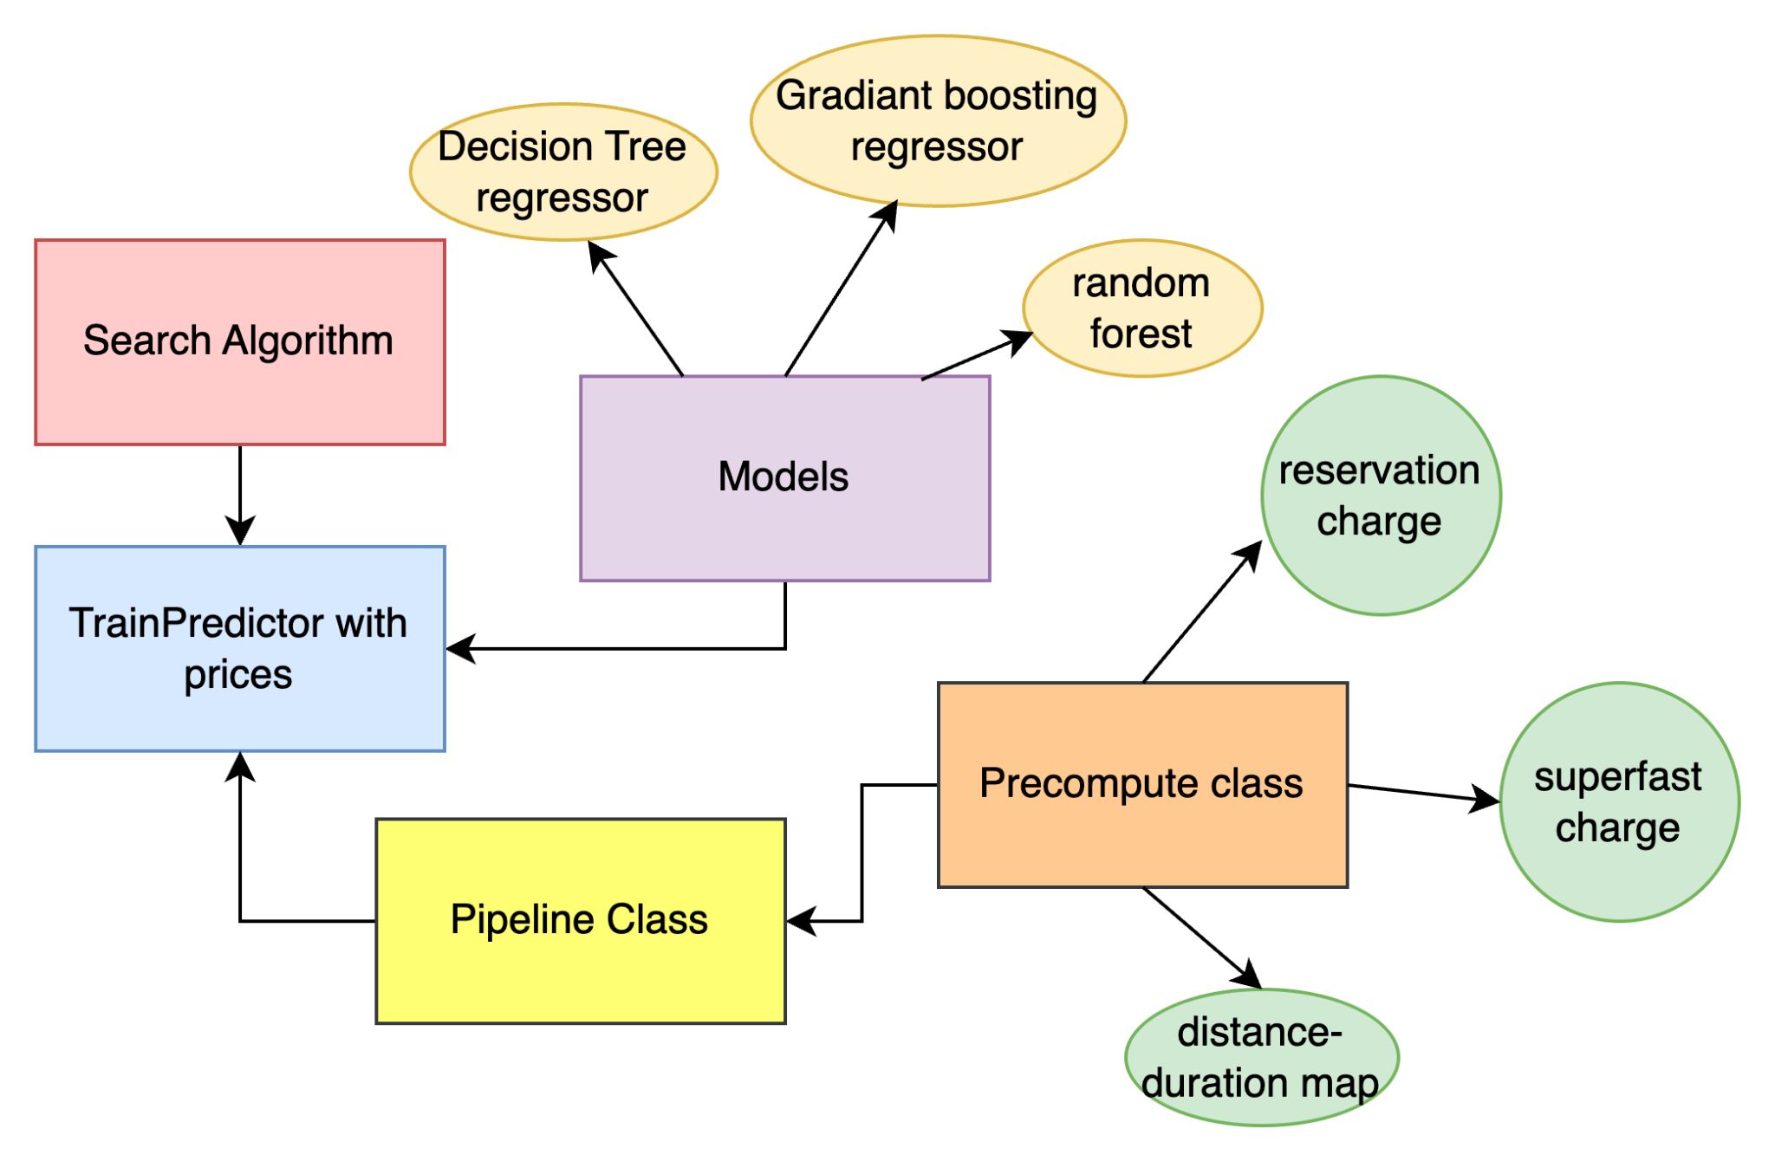
Introduction
Proposed approach
Results
Conclusion
References
Combined Work
In the combining step, we use the coded search algorithm class and pre-built model and also use the precomputed data of fixed prices and train specialities during the invocation of the model.
Data Pipeline class's job is to provide a function called send_input (to pipeline),it concatenates new columns and transforms existing columns . It makes it very easy to switch between models.
TripPlannerWithPrices class is our project's final class. The main query function would take user input of form station, to station and date; and compute final fares
Simultaneous Inpainting and Sr-resolution
Train Tripper
Notes:
In the combining step, we use the coded search algorithm class and pre-built model together to generate a nice output of possible trains along with their estimated prices. We also use the precomputed data of fixed prices and train specialities during the invocation of the model.
DataPipeline class's job is to provide a function called send_input (to pipeline) which when given a dataframe with trainNumber, fromStnCode, toStnCode and depending on the user class preference it concatenates new columns and trasforms existing columns such a way that the output is feed-able to the model. As every single model takes same input, it makes very easy to switch between models.
TripPlannerWithPrices class is our project's final class that would only be used by the user. The main query function would take user input of form station, to station and date; it would use the TrainsFinder class to search direct and indirect trains from the user, use DataPipeline to transform the output of TrainsFinder class to be fed in the model, use prebuilt model to predict the prices and use send_output function of DataPipeline to compute final fares

Slide 18
Introduction
Proposed approach
Results
Conclusion
References
Conclusion and Future Work
Successful achievement of project objectives.
Integration of machine learning for enhanced accuracy.
System's contribution to accurate and efficient train travel information.
Implementation of availability prediction and also predict the waiting list.
Continuous data updates for real time data.
Implementation of web application so that users can use our project more easily.
Simultaneous Inpainting and Sr-resolution
Train Tripper

Slide 19
Introduction
Proposed approach
Results
Conclusion
References
Let’s Do the Demonstration
Running the final created API and look and understand the created CSV file columns.
Performing the sort and filter operations convenience
GitHub link: https://github.com/bhavya2403/TrainTripper
THANK YOU
Simultaneous Inpainting and Sr-resolution
Train Tripper

